Slide 1
Dynamic and Recurrent Neural networks
Yanxin Wang and Keyvan Golestan
July 6th, 2012

Slide 2
Outline
Introduction
Categorization
Literature
Learning Algorithms
Applications
An Example
Future Goals
Conclusion

Slide 3
Dynamic Neural Networks
Definition
Neural networks can be classified into dynamic and static categories.
Static networks: the output is calculated directly from the input
Dynamic networks: the output also depends on the previous inputs, outputs or states of the network.

Slide 4
Dynamic Neural Networks
Categorization
Dynamic networks can be divided into two categories:
Non-recurrent networks: the output does not become input
Recurrent networks: have feedback connections

Slide 5
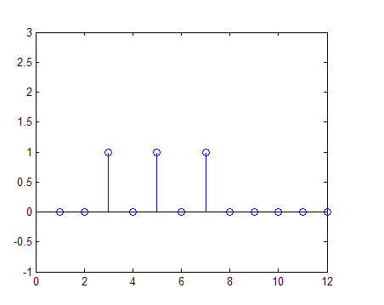
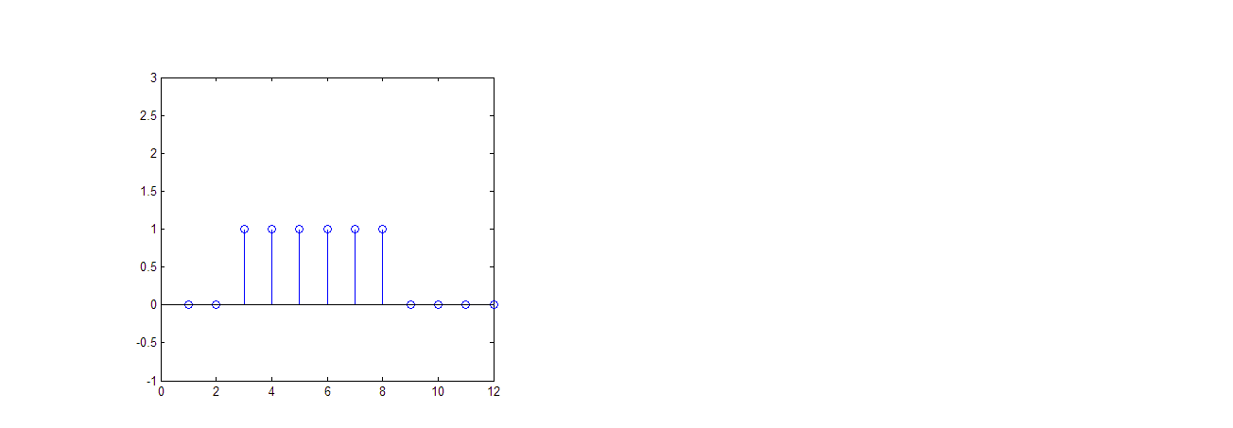
Dynamic Neural Networks
An Example
Non-recurrent network sample:
P(t)
output
∑
/
D

Slide 6
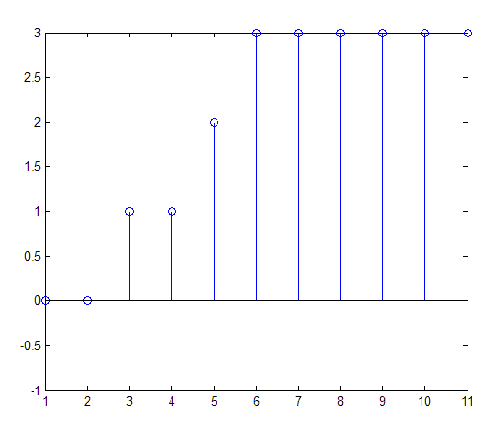
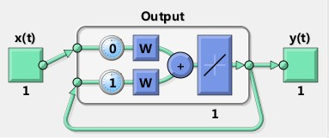
Dynamic Neural Networks
An Example
Recurrent network sample:

Slide 7
Recurrent Neural Networks
Literature
The recurrent network: ”Automata Studies” (Kleene 1954)
The NARX model (Leontaritis & Billings 1985)
Recurrent network architectures (Jordan 1986)

Slide 8
Recurrent Neural Networks
Architectures
Architectures
Symmetrical:
Hopfield networks
Asymmetrical:
Totally recurrent networks
Partially recurrent networks:
Elman networks
Jordan networks

Slide 9
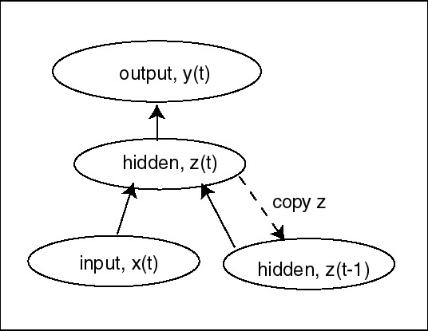
Recurrent Neural Networks
Elman Network

Slide 10
Recurrent Neural Networks
Training Methods
Training Methods
Gradient Descent:
Back-Propagation Through Time
Real-Time Recurrent Learning
Global Optimization Methods
Genetic Algorithms

Slide 11
Real-time Recurrent Learning
Learning Method
In a fully recurrent network, output i given by
Cumulative error over “T”, denote as

Slide 12
Real-time Recurrent Learning
Learning Method
Our target is to minimize the cumulative error in weight space:
We define the update of the weight:
Where is the learning rate and

Slide 13
Real-time Recurrent Learning
Learning Method
Where
If we denote , then we have

Slide 14
Real-time Recurrent Learning
Learning Method
and
The total weight correction over times
is given as

Slide 15
Real-time Recurrent Learning
Pros and Cons
Advantages: on-line training method
Disadvantages: Computational complexity

Slide 16
Recurrent Neural Networks
Applications
Categorization
Chaos: Tackling the sensitivity to the initial states
E.g. Solar Weather Prediction
Prediction/Optimization: Estimation of the next state
E.g. Travel time prediction
Control: Adaptive and non-linear control systems
E.g. Autonomous Underwater Vehicle control

Slide 17
Recurrent Neural Networks
Applications
Dynamic Recurrent Neural Networks are uses in these areas:
Telecommunication
Control of chemical plants
Control of engines and generators
Fault monitoring, biomedical diagnostics and monitoring
Speech recognition
Robotics, toys and edutainment
Video data analysis
Man-machine interfaces
Stock Market Prediction

Slide 18
Prediction/Estimation
An Example
(Wen et al. 2005) introduces a Real-time Travel Time Estimator by Using Grey-based Recurrent Neural Networks
Problem: Rapid forecasting of travel time with reasonable accuracy is an emerging issue towards travel time estimation.
Solution: Authors first tackle the problem of missing data, then use grey-based RNN to predict the travel time

Slide 19
Travel Time Prediction
Solution
Missing data treatment
Temporal missing data
Grey time series
Spatial missing data
Grey-relational-based nearest neighbour
Real-time travel time prediction
The grey-based recurrent neural networks integrate grey modeling into recurrent neural networks that are capable of dealing with both randomness and spatial-temporal properties in traffic data implicitly

Slide 20
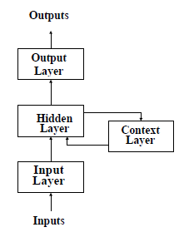
Travel Time Prediction
Solution
Approach remarks
Dynamic inherence of travel time refers to both spatial and temporal patterns of traffic data
Elman RNN is used as the underlying network
Learns complex spatial-temporal patterns
Feedback from output of the hidden layer to its input
Uncertainties and random fluctuations in data significantly degrades the forecasting feature of RNNs
In this method, grey models are integrated with RNNs to address mentioned problems

Slide 21
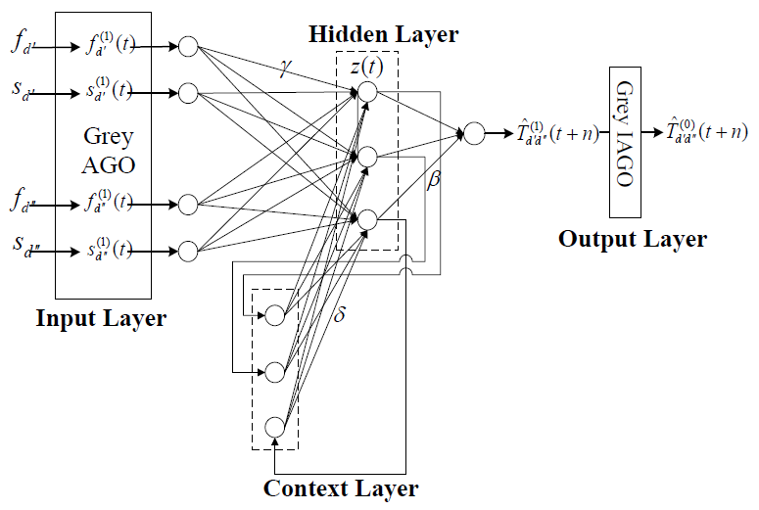

Travel Time Prediction
Volume and Speed data from upstream station
Structure
Travel time at some future time interval
Volume and Speed data from downstream station
Feedbacks
AGO Formations

Slide 22


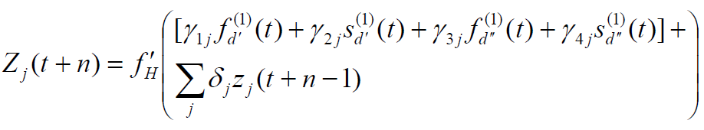
Travel Time Prediction
Structure
IAGO for travel time estimation

Slide 23
Travel Time Prediction
Network Learning
Network undergoes a training process during which the weights are determined
Learning is same as back-propagation methods using gradient descent

Slide 24
Travel Time Prediction
Network Learning
The training process continues until the prediction errors (MSE) become very small and the network parameters converge to values that allow it to perform the desire mapping for each input-output correlation
Once the grey-based RNN is trained, it can then be used on-line to provide link travel time estimation based on new real-time data

Slide 25
Case Study
Simulation Setup
Real world problem in a freeway in Taiwan
Data collected from 10 detectors set up at 500m intervals
Main goal is to study the morning peak hour (8:00am to 9:00am) during one week in September 2002
After initial data processing on data, it was shown that 25% of them are missing.

Slide 26
Case Study
Simulation Setup
A group of complete data records from 6 detectors are used for comparison
The original data records are converted at 3 out of 6 detectors into test datasets with increasing amount of missing
spatial data from 10% to 40%
mixed data from 50% to 80%
Randomly chosen based on uniform distribution

Slide 27
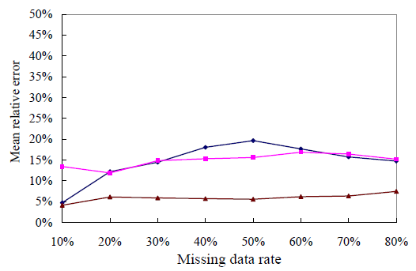
Case Study
Results: Missing Data Treatment
Results are evaluated based on the mean relative error percentage compared with original complete dataset
Test dataset 3
Test dataset 2
Test dataset 1

Slide 28
Case Study
Results: Travel Time Prediction using RNN
Grey-based RNN is trained using offline estimated travel times
Two procedures are tested:
Incorporation of missing data treatment methods, that yields a mean squared error of 0.00133
partially missing data, that results in a mean squared error of 0.00154

Slide 29
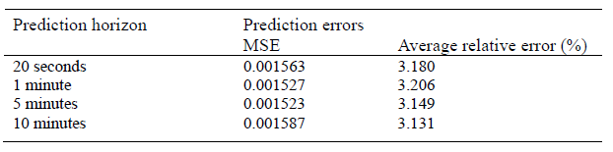
Case Study
Results: Travel Time Prediction using RNN
Forecasting performance of Grey-based RNN for travel time estimation

Slide 30
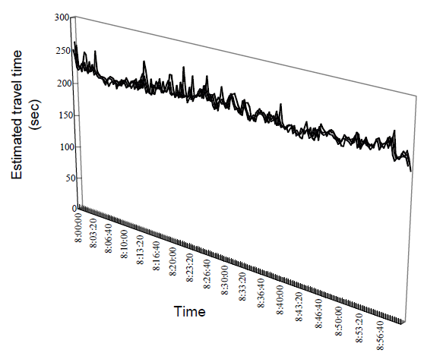
Case Study
Results: Travel Time Prediction using RNN
The estimated section travel times using the grey-based RNN models trained by off-line estimated travel times

Slide 31
Future Goals
Implementation of the introduced recurrent neural network for our presentation report
Studying the usefulness of the proposed method for other applications such as real-time localization

Slide 32
Conclusion
Introduction of Recurrent Neural Networks (RNNs)
Different categories and common topologies of RNNs
Different learning algorithms of RNNs
Applications of RNNs
An example of using RNNs for prediction

Slide 33
References
[1] J. Vandegriff, K. Wagstaff, G. Ho, and J. Plauger, “Forecasting space weather: Predicting interplanetary shocks using neural networks,” Advances in Space Research, vol. 36, no. 12, pp. 2323-2327, Jan. 2005.
[2] Y.-jen Mon and C.-min Lin, “Supervisory Recurrent Fuzzy Neural Network Guidance Law Design for Autonomous Underwater Vehicle,” vol. 14, no. 1, pp. 54-64, 2012.
[3] B. A. Pearlmutter, “Dynamic Recurrent Neural Networks,” vol. 196, no. 7330, 1990.
[4] Y.-horng Wen and T.-tian Lee, “Missing Data Treatment And Data Fusion Toward Travek Time Estimation For ATIS,” vol. 6, pp. 2546-2560, 2005.
[5] F. J. Pineda, “Generalization of Back-Propagation to Recurrent Neural Networks,” vol. 59, no. 19, pp. 2229-2232, 1987.

